Slide 1
The Gospel According to Luke
Preaching Considerations and Ideas
Thomas Magers II, PhD
Blue Mountain Christian University

Slide 2
Major Elements of a Sermon
Foundational Elements
  Bible Verse(s)
  ETS; Big Idea, CIT (I use MPT)
  Proposition
Formal Elements
  Introduction
  Body
  Conclusion
Functional Elements
  Explanation
  Argumentation
  Illustration
  Application

Slide 3
Main Point of the Text (MPT): The MPT is a past tense statement about what the text mean in its historical context.
Main Point of the Sermon (MPS): The MPS is a present or future tense application of the MPT stated in a single sentence (sticky statement).
Objective of the Sermon in a Sentence (OSS): What hearers will do as a result of the sermon; a simple sentence expressed in the present or future tense.
Probing Question (PQ): A question that will guide the development of the sermon that is based upon the biblical passage.

Slide 4
OSS - Objectives
C – consecrative: seeks to enlist Christians in service to God
C – comforting: seeks to help people with troubles, problems, and difficulties
D – doctrinal: seeks for Christians to understand God better
D – devotional: seeks for Christians to love, worship, and adore God
E – evangelistic: seeks the salvation of sinners
E – ethical: seeks to strengthen the conduct of Christians
H. C. Brown, A Quest for Reformation in Preaching

Slide 5
Why the Gospels?
Gospels are inherently Christocentric.
  Who is Jesus?
  What did Jesus do?
  What did Jesus say?
Gospels are inherently evangelistic.
  Written so you may believe . . . Believe so you have eternal life (John 20:31).
  Jesus’ words, actions, and substitutionary death point to salvation.

Slide 6
Why the Gospels?
Gospels are inherently didactic.
  Jesus teaches the demands of being a disciple.
  Jesus teaches disciples how to pray.
Gospels are inherently image-rich.
  People love stories.
  The Gospels are full of interesting stories about people with real life problems.
  The Gospels have glimpses of action, dialogues, anger, sadness, grief, confusion, etc.

Slide 7
Preaching the Gospels
Preaching from Narratives
  Use full narrative (the complete pericope)
  Consider Inductive Approach instead of Deductive
    Tell the story
    Save proposition for the end
    Either weave application into the sermon or save for the end
Preaching from the Parables
  Determine the meaning
  Modernize the language in the explanation (if needed)

Slide 8
Preaching the Parables
Not every element of the parable should be treated as an allegory (unless Jesus does so like in the Sower and the Seed).
Take note of the main persons
  Many of Jesus’ parables have three persons (King, two servants; Father, two sons).
  Usually, a father or king points to God
Begin with the idea of finding one main point, until proven otherwise.

Slide 9
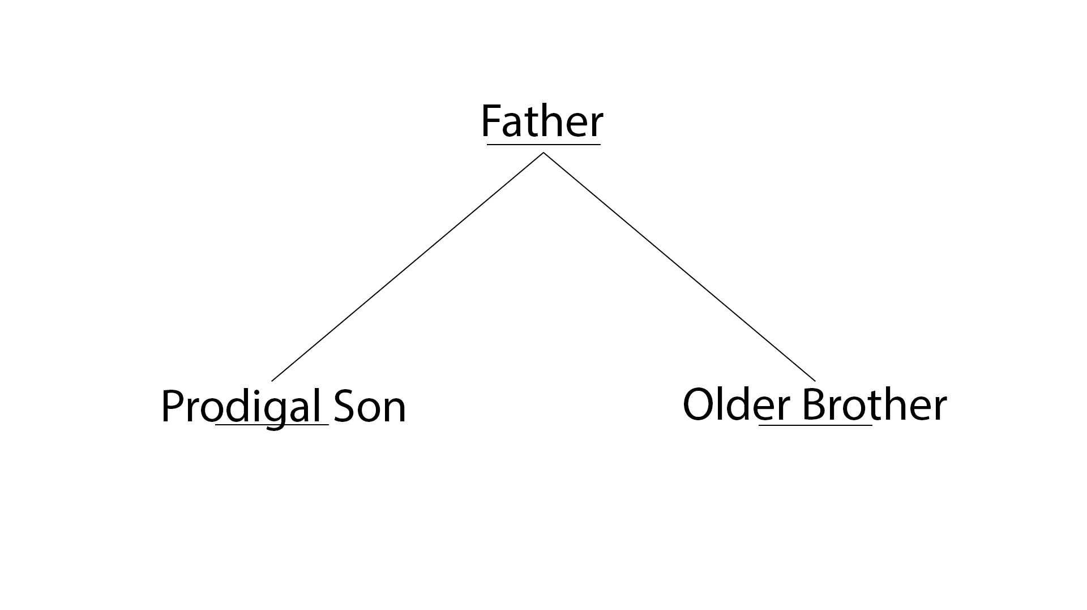

Slide 10
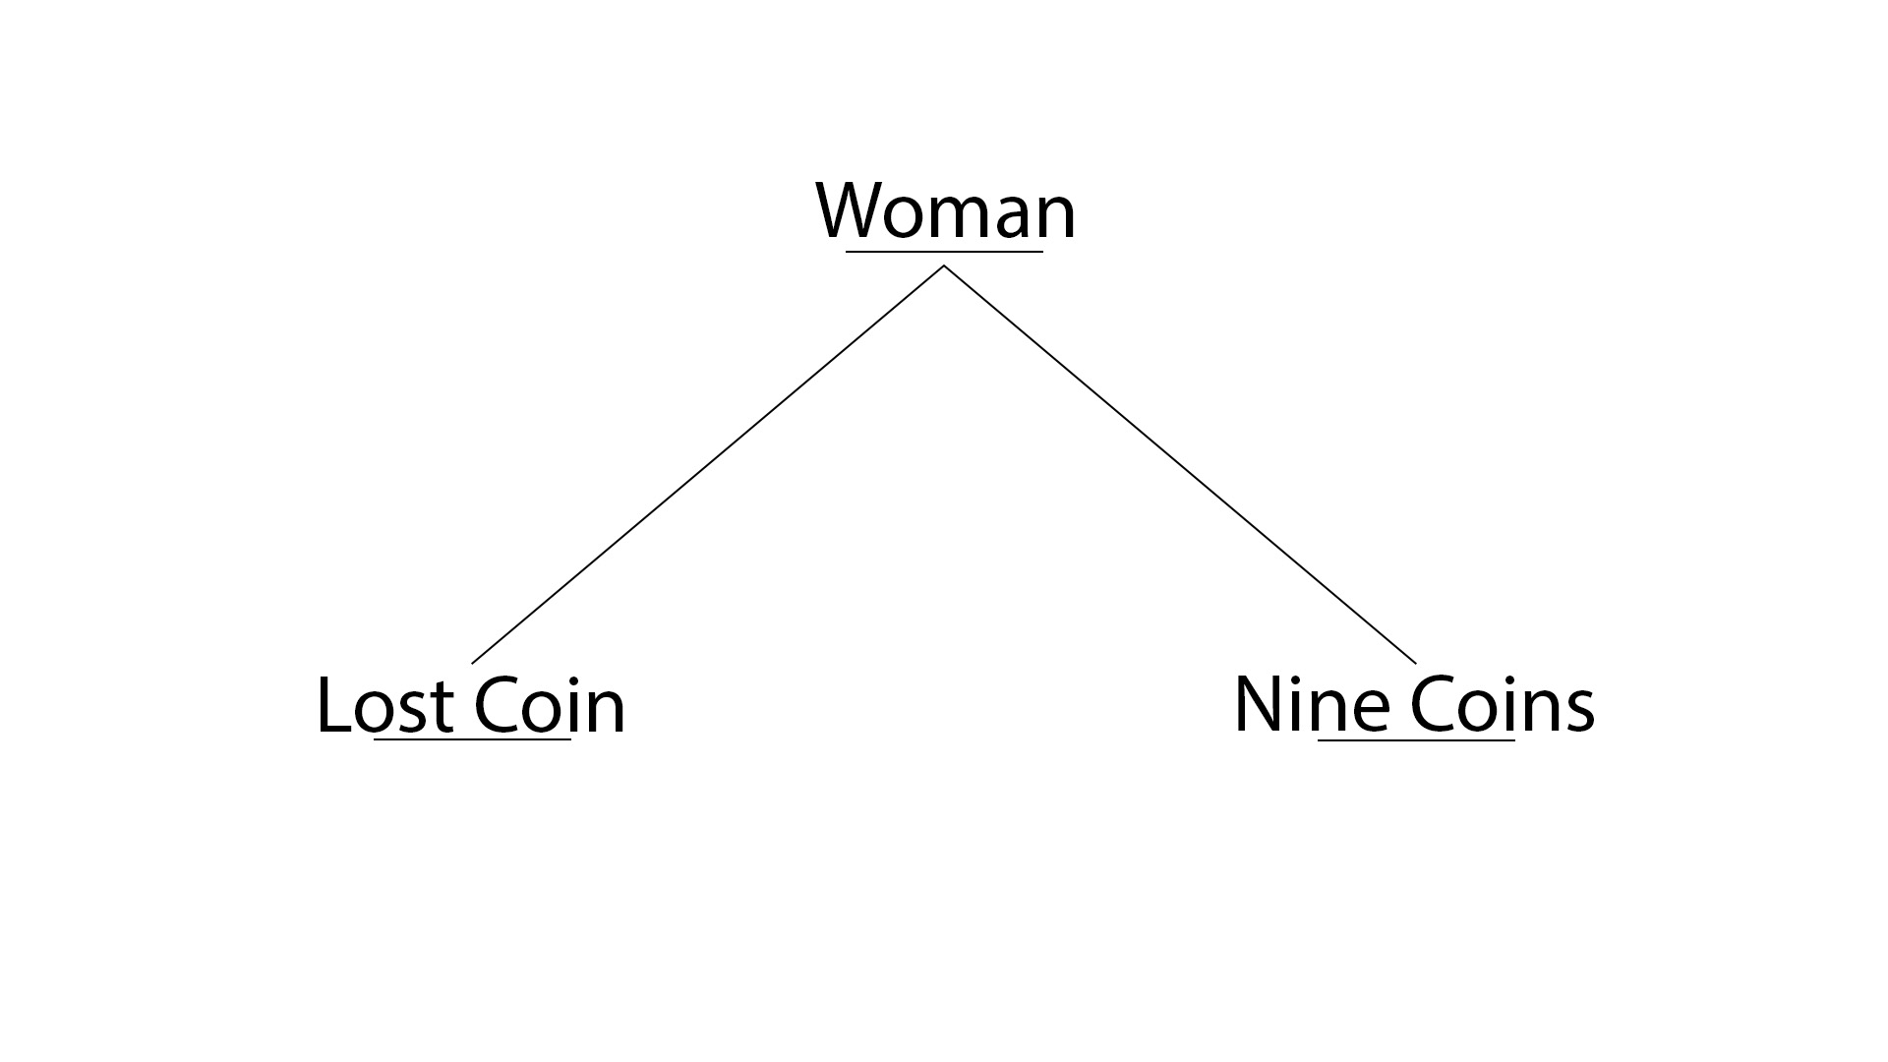

Slide 11


Slide 12
Songs of Christmas
The Magnificat – Luke 1:46-56
Benedictus – Luke 1:69-79
Gloria in excelsis Deo – Luke 2:13-14
Nunc Dimittis – Luke 2:29-32

Slide 13
Sermon on the Plain
The Sermon on the Plan is like the Sermon on the Mount, but a little different.
A Plain Sermon: Blessings and Woes
A Plain Sermon: Love Your Enemies!
A Plain Sermon: Principles 4 Life
A Plain Sermon: The Right Choice

Slide 14
Unique Parables to Luke
Two Debtors – Luke 7:41-43
Good Samaritan – Luke 10:30-37
Persistent Friend – Luke 11:5-8
Rich Fool – Luke 12:16-21
Barren Fig Tree – Luke 13:6-9
Lost Coin – Luke 15:8-10
Lost Son – Luke 15:11-32
Unrighteous Manager – Luke 16:1-9

Slide 15
Unique Parables to Luke
Rich Man and Lazarus – Luke 16:19-31
Unjust Judge – Luke 18:1-8
Pharisee and the Tax Collector – Luke 18:9-14

Slide 16
Special Emphasis on Women in Luke
Women served and supported Jesus’ ministry in the First Century (Luke 8:1-3).
Jesus praised Mary for worshipping at His feet (Luke 10:38).
Jesus commended the poor widow for her offering (Luke 21:1-4).
Jesus warned the “Daughters of Jerusalem” to weep for themselves instead of Him (Luke 23:27-31).
An angel encouraged the women to tell His disciples of Jesus’ resurrection (Luke 23:55-24:11).

Slide 17
Jesus’ Prayer Ministry
Jesus prayed at His baptism (Luke 3:21).
Jesus prayed after busy days (Luke 5:16).
Jesus prayed before selecting the disciples (Luke 6:12).
Jesus taught the pattern of prayer (Luke 11:1-4).
Jesus taught persistence in prayer (Luke 11:5-13).
Jesus taught persistence in prayer (Luke 18:1-8).
Jesus prayed for Peter before his testing (Luke 22:31-32).

Slide 18
Jesus’ Final Week
Sunday: Royal Entry into Jerusalem (19:29-44)
Monday: Cleansing the Temple (19:45-48)
Tuesday
  Withered Fig Tree (21:37-38)
  Questioning Jesus’ authority (20:1-8)
  Jesus’ response with three parables (20:9-19)
  Question about Taxes (20:20-26)
  Question about the Resurrection (20:27-40)
  Christ greater than David (20:41-44)
  Woes Against the Scribes and Pharisees (20:45-47)
  Widows Gift (21:1-4)
  Olivet Discourse (21:5-36)

Slide 19
Jesus’ Final Week
Thursday
  Preparing for the meal (22:7-13)
  Beginning of meal, and dissension of disciples (22:14-16, 24-30)
  Judas identified (22:21-23)
  Prediction of Peter’s denial (22:31-38)
  Institution of the Lord’s Supper (22:17-20)
Friday
  Arrest and Trials (22:47-23:25)
  Journey to Golgotha (23:26-33)
  First Three Hours (23:33b-43)
  Last Three Hours (23:44-45a, 46)
  Jesus’ Death (23:45b, 47-49)
  Jesus’ Burial (23:50-56)

Slide 20
Via Dolorosa
The Son of Man must suffer many things (9:22).
Jesus must be turned over, mocked, scourged and killed (18:31-34).
He set His Face towards Jerusalem
  9:51
  13:33
  17:11

